Slide 1

Deploying OpenTelemetry Application in EKS
Final Project - Group 18
Aashay Mehta, Aryan Kulshrestha, Long Le, Gideon Marcus Jayakumar, Ali Huangz

Slide 2
Introduction
This project explores the complete lifecycle of deploying, monitoring, and automating a cloud-native application using DevOps tools.
It is structured across multiple independent phases to simulate real-world production scenarios using container orchestration, monitoring stacks, performance testing, and CI/CD pipelines, all within AWS cloud infrastructure and GitHub.
Technologies used: AWS, GitHub Actions, VScode, Docker, Kubernetes

Slide 3
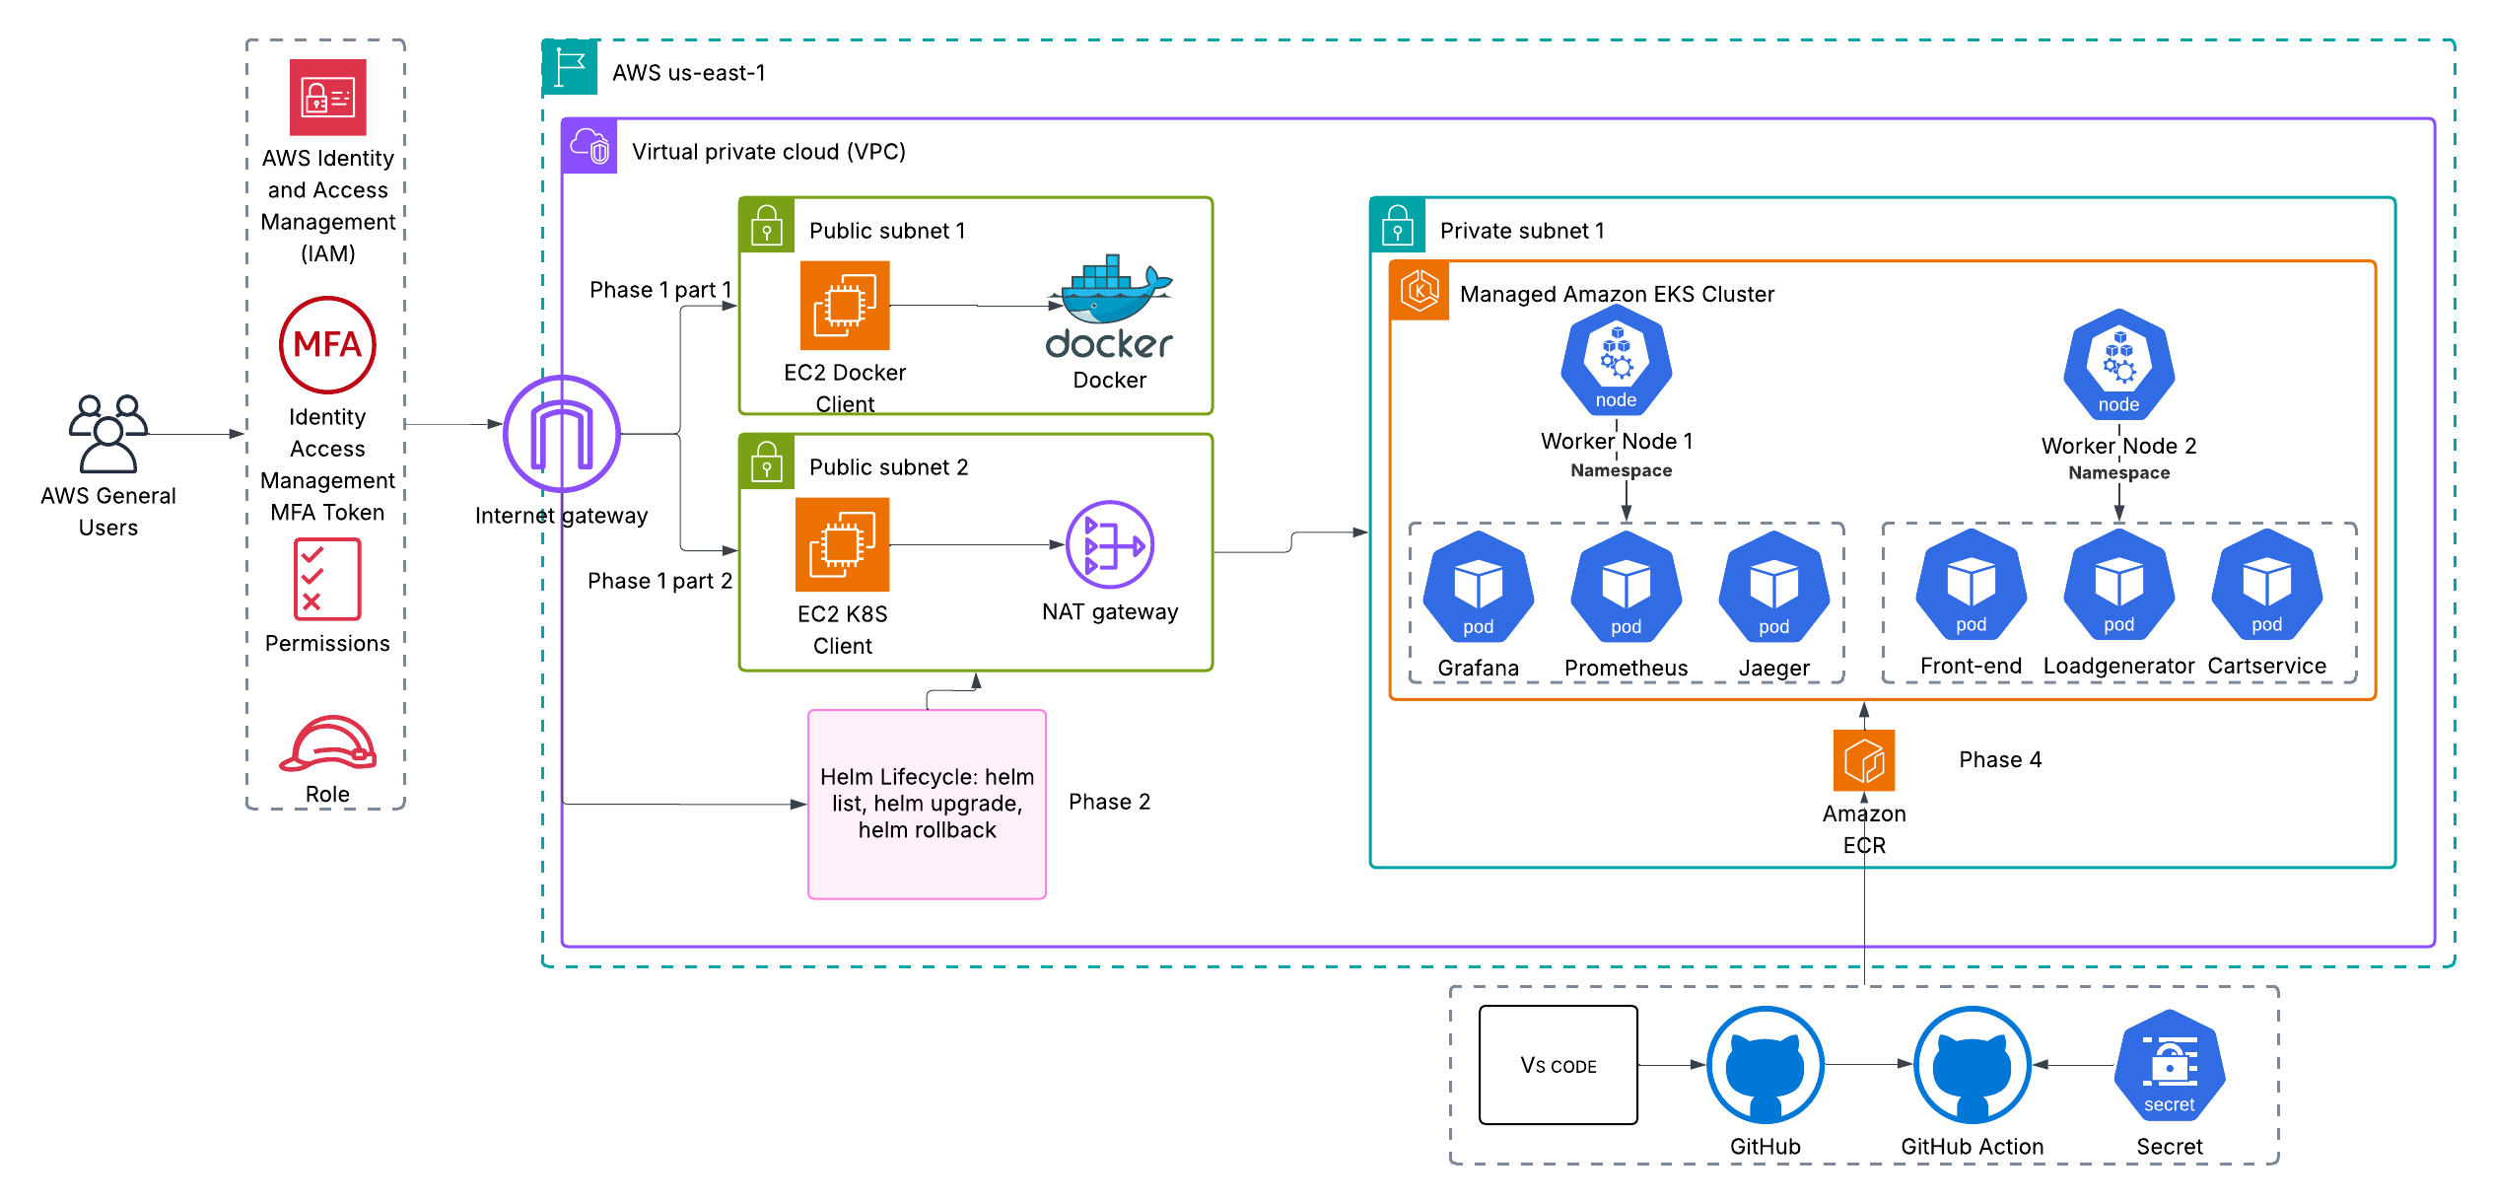
Architecture Diagram

Slide 4
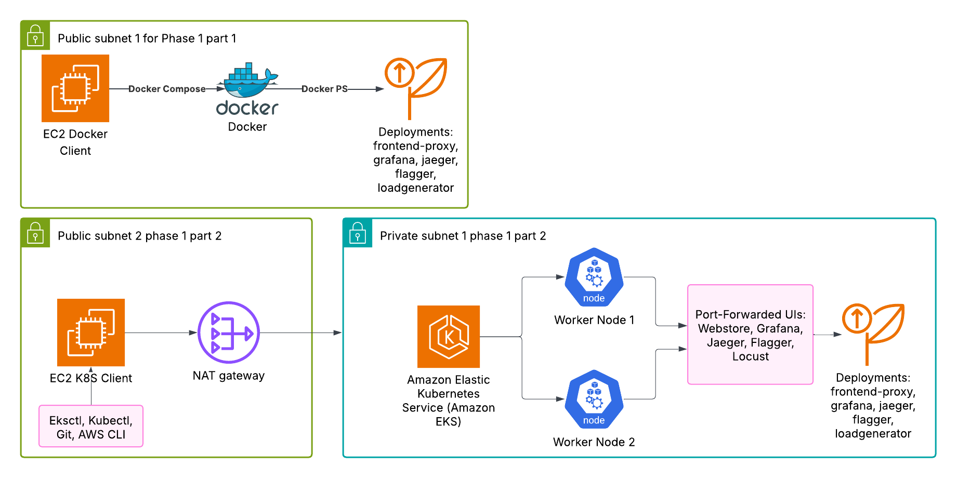
Phase 1 Architecture Diagram

Slide 5
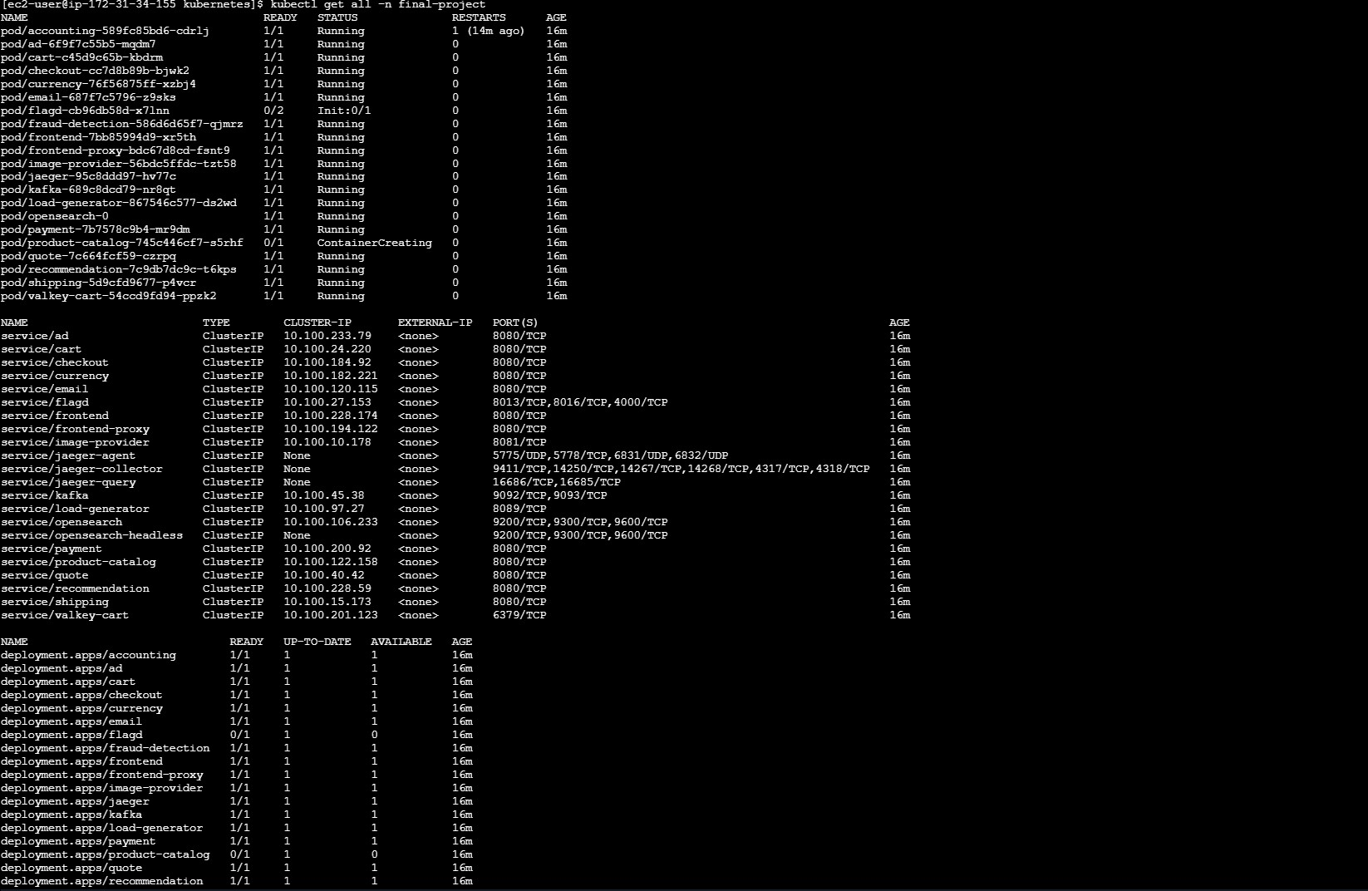
Phase 1: Environment Setup - Part 1
Screenshot showing all Kubernetes deployments

Slide 6
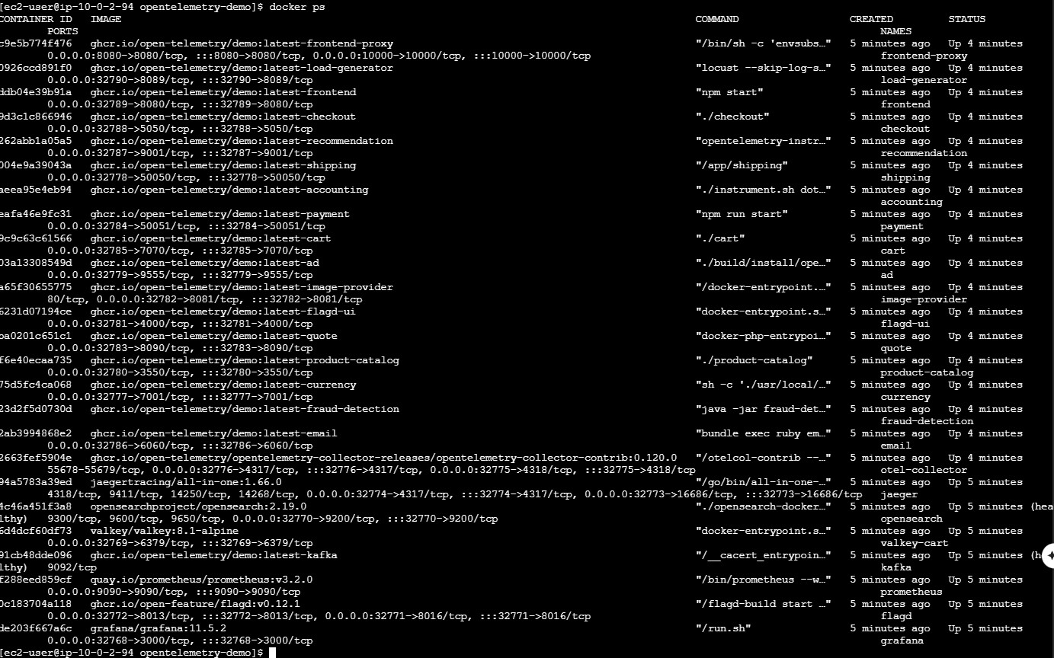
Phase 1: Environment Setup - Part 2
Screenshot showing all running containers

Slide 7
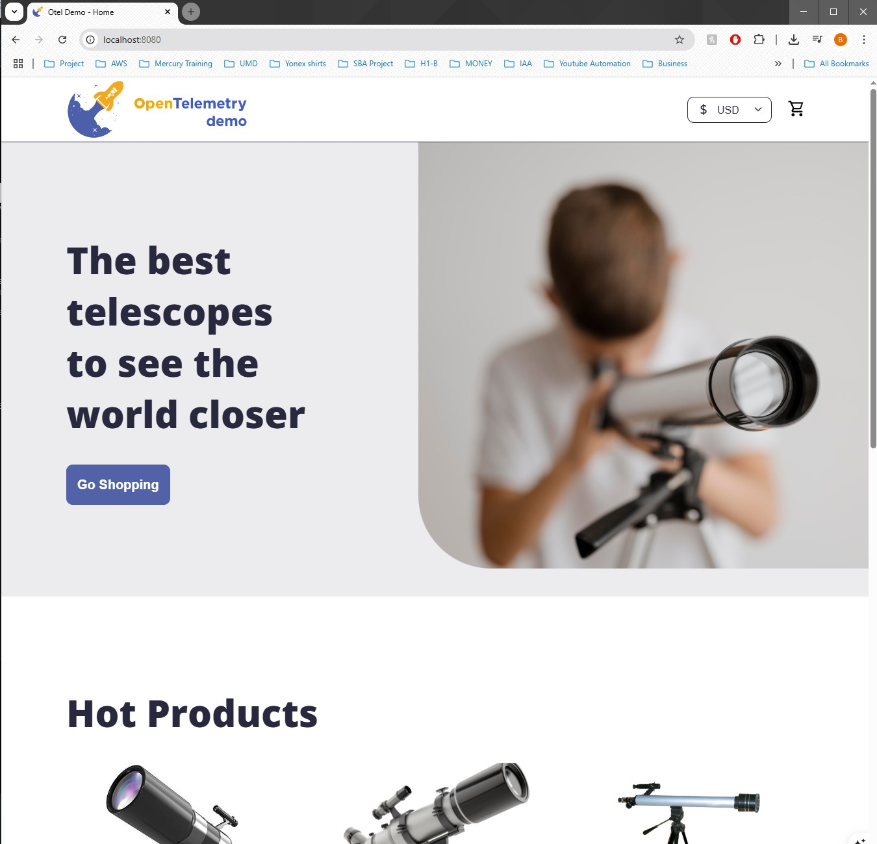
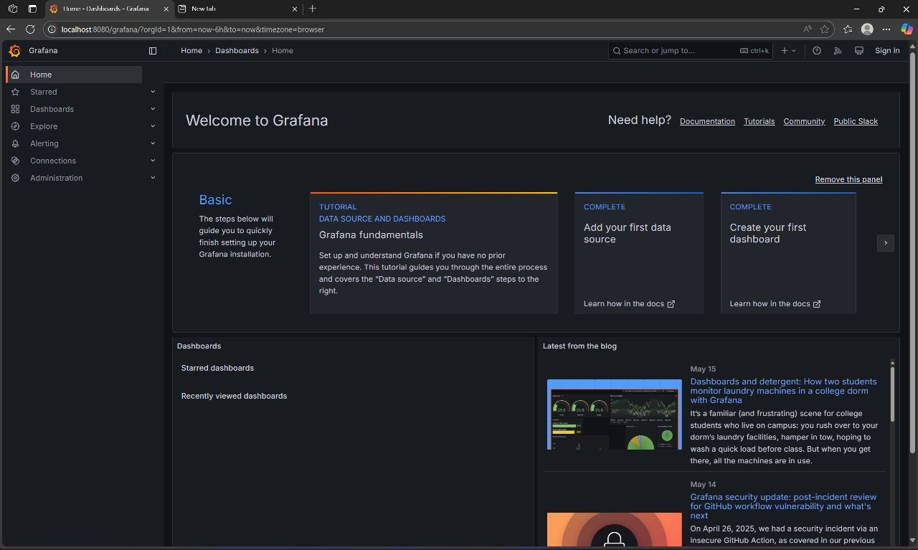
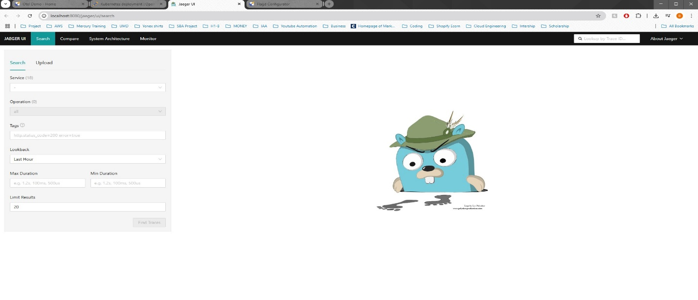
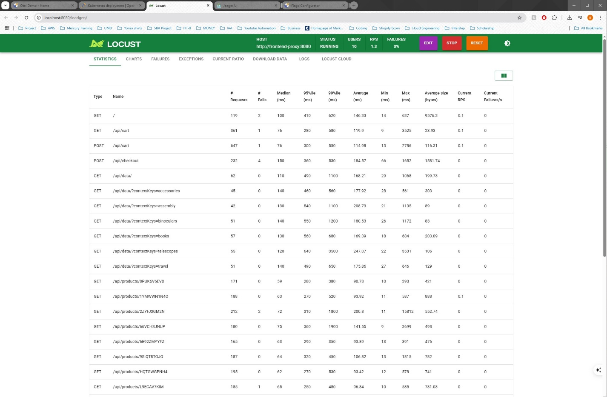
Phase 1: Environment Setup - Part 3

Slide 8
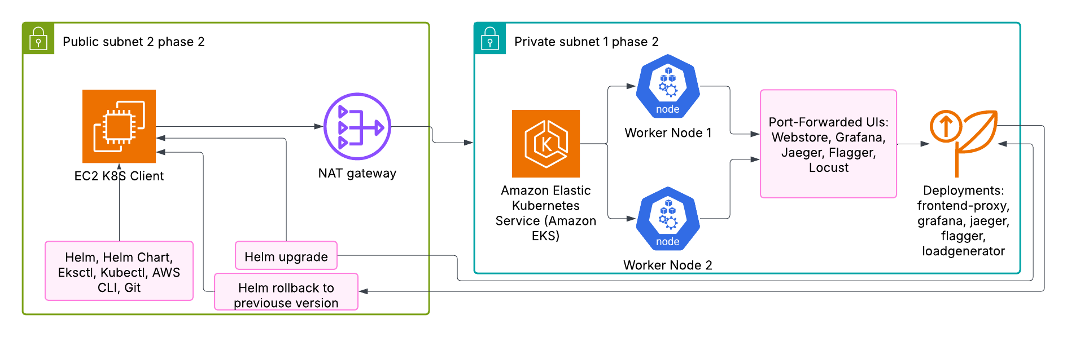
Phase 2 Architecture Diagram

Slide 9
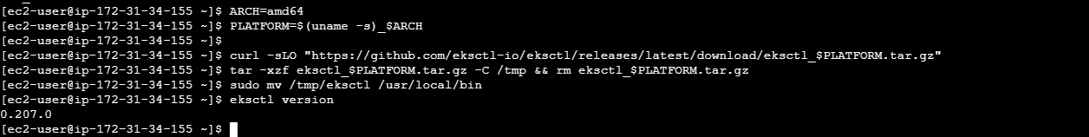
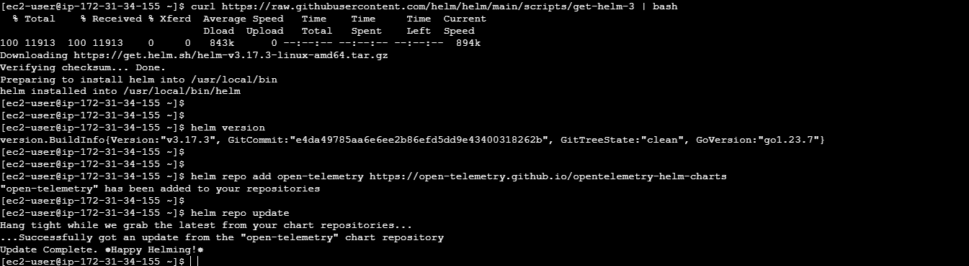
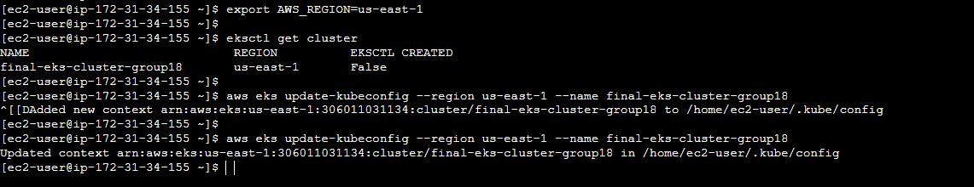
Phase 2: Helm Deployment - Part 1
Installation of eksctl, helm, and mapping kubectl with our EKS Cluster

Slide 10
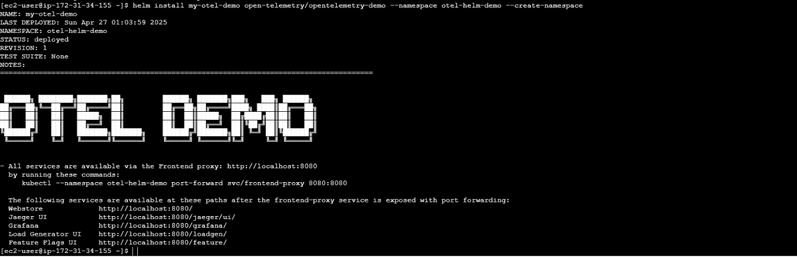
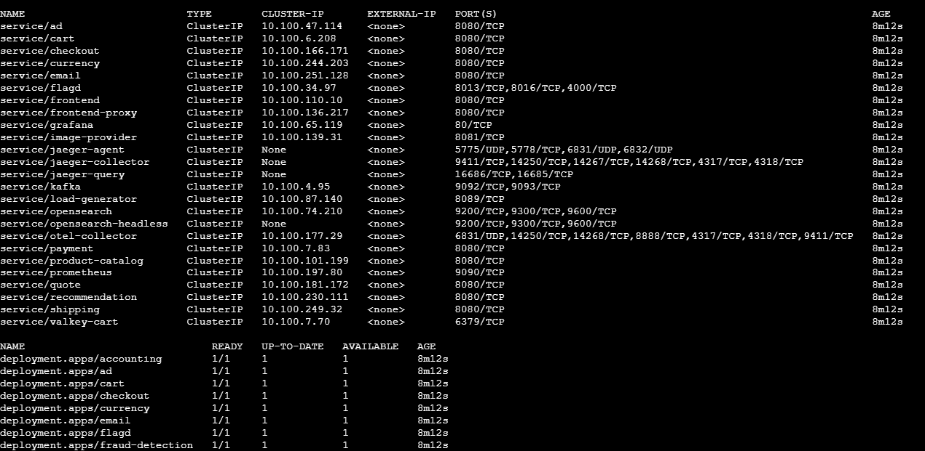
Phase 2: Helm Deployment - Part 2
Deployment and Verification

Slide 11
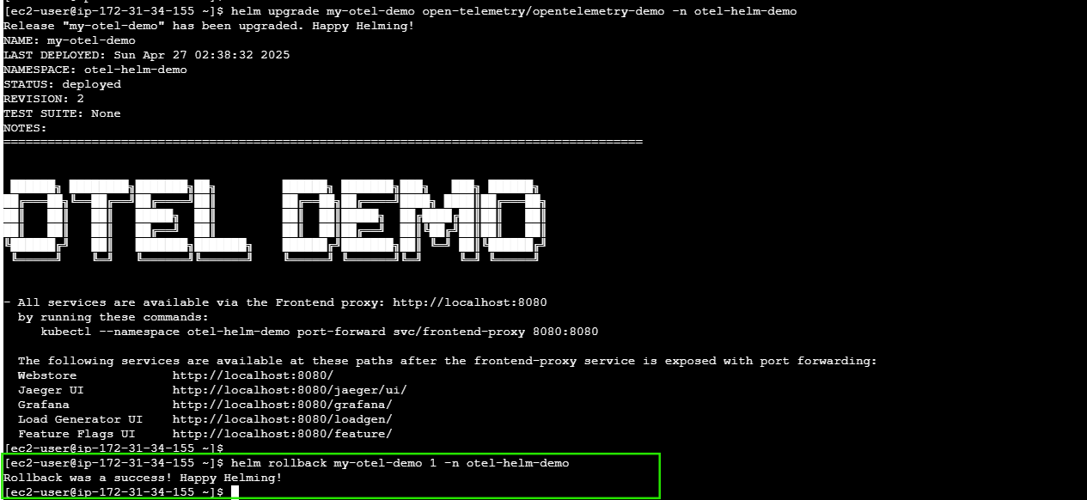
Phase 2: Helm Deployment - Part 3
Helm Rollback

Slide 12
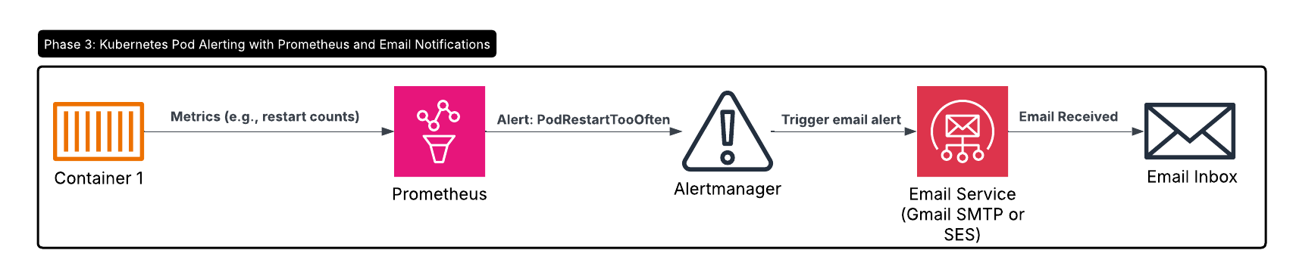
Phase 3 Architecture Diagram

Slide 13
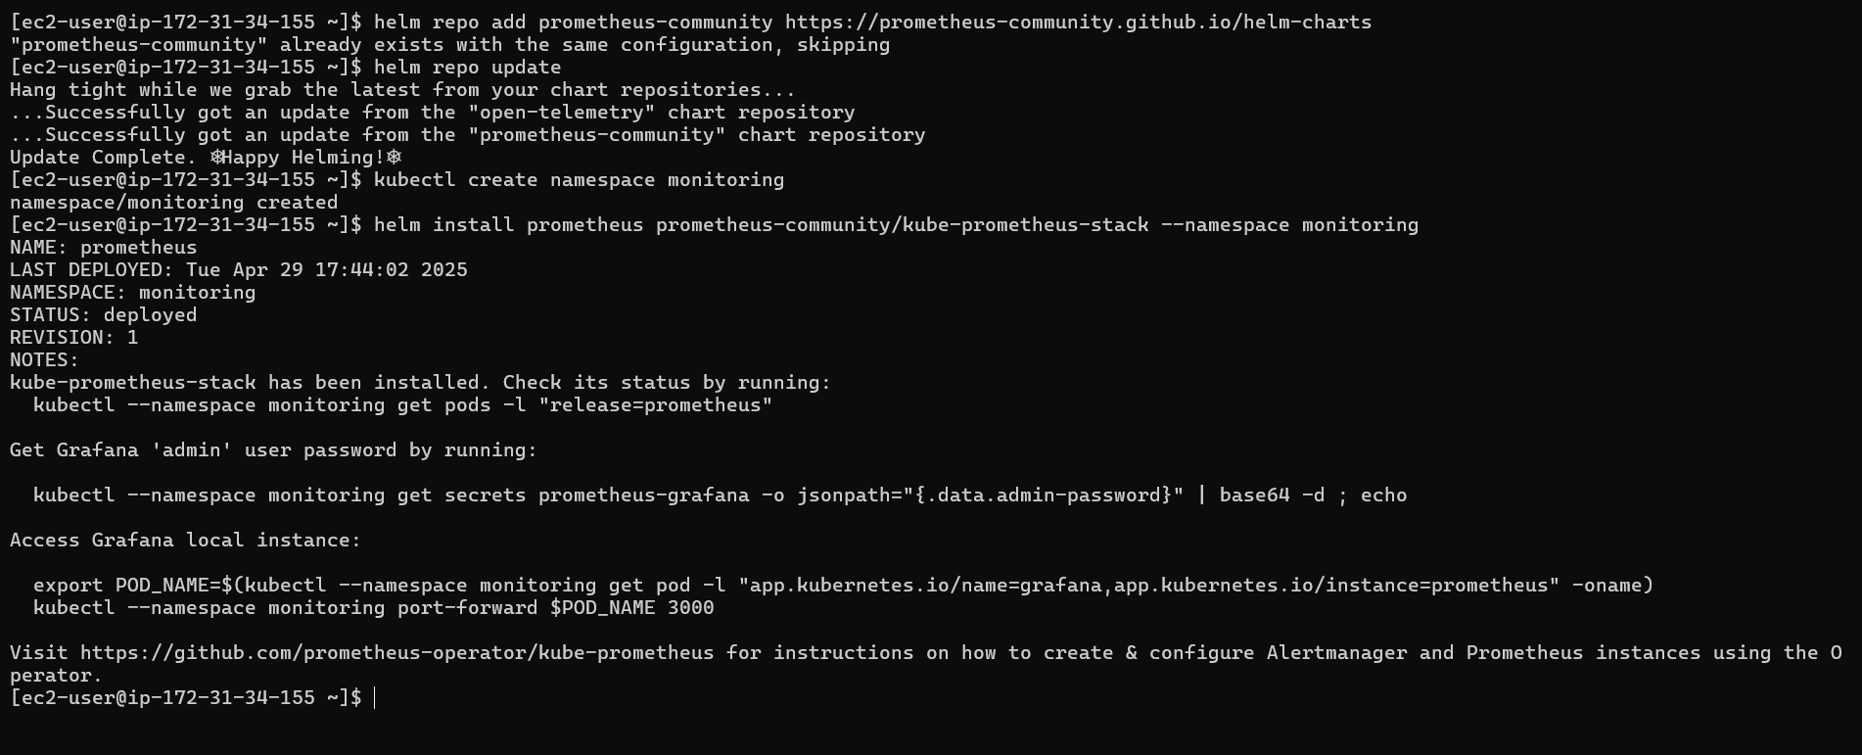
Phase 3: Alerting & Notifications - Part 1
Prometheus Stack Deployment

Slide 14
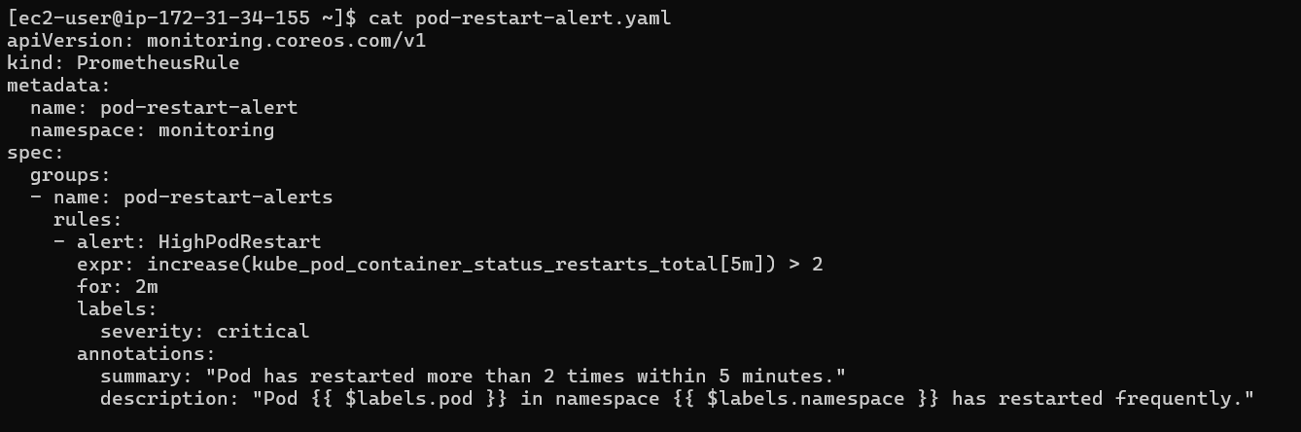
Phase 3: Alerting & Notifications - Part 2
High Pod Restart Rule present in YAML file

Slide 15
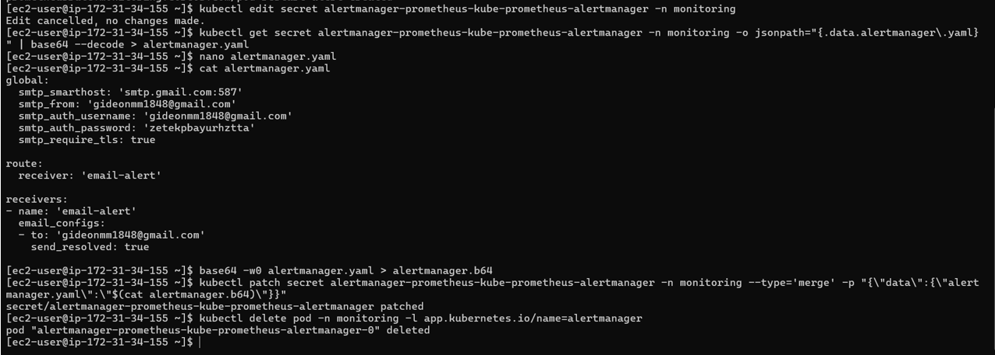
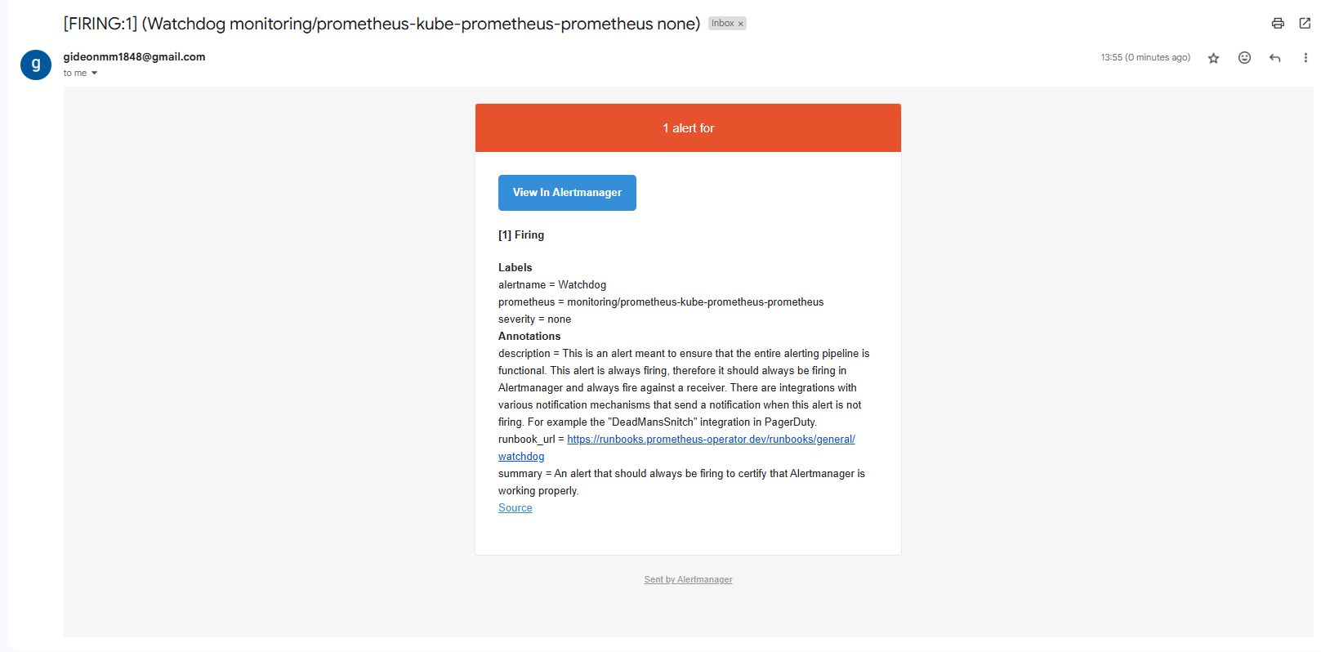
Phase 3: Alerting & Notifications - Part 3

Slide 16
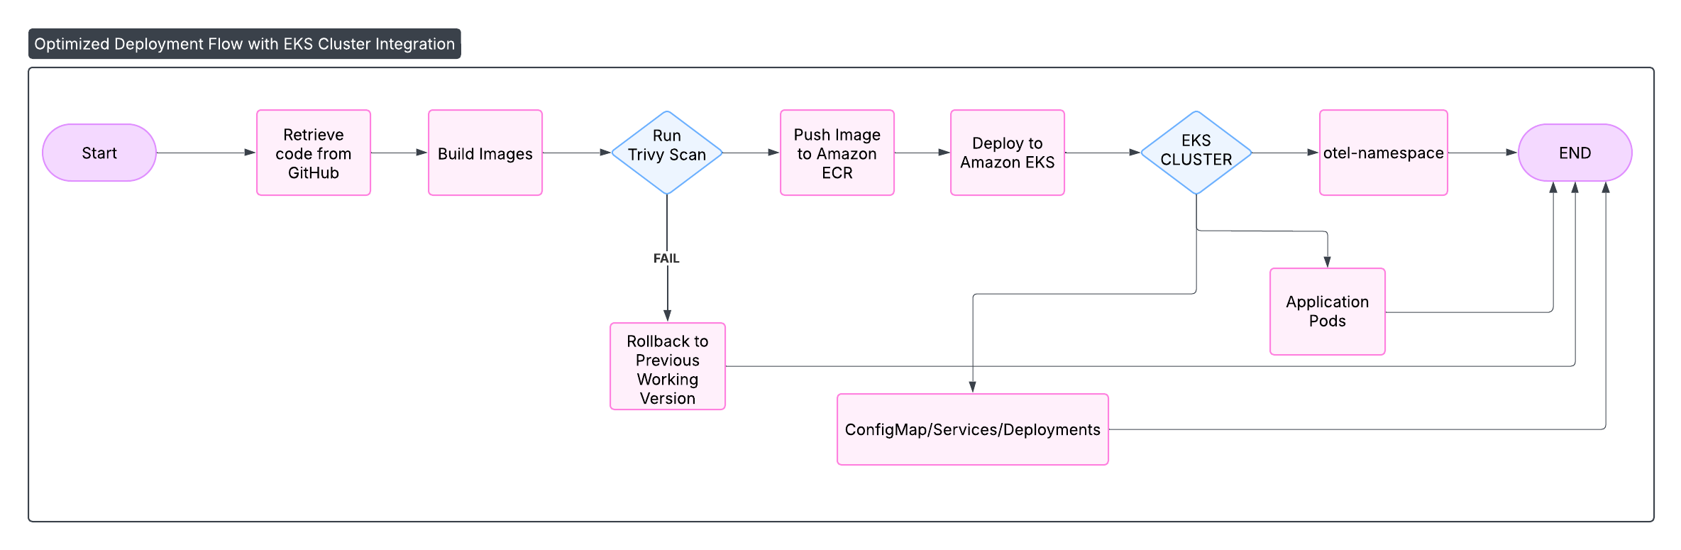
Phase 4 Architecture Diagram

Slide 17
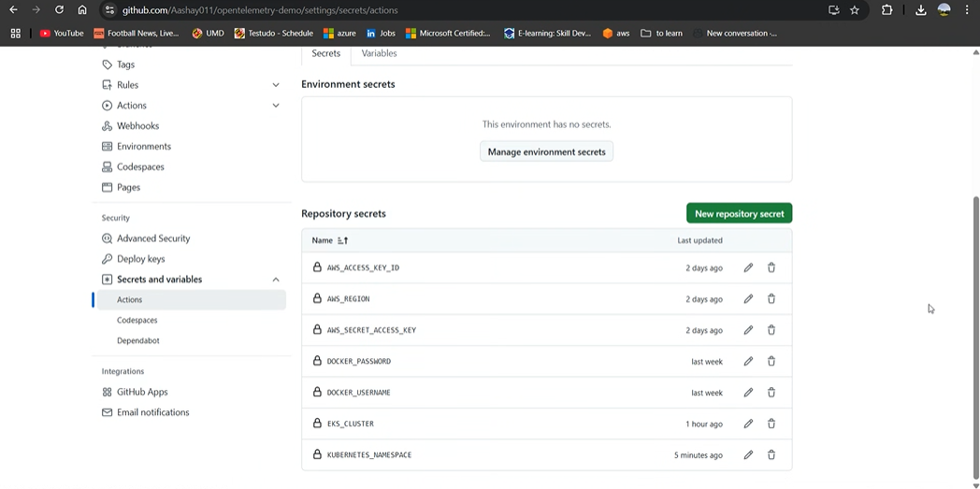
Phase 4: CI/CD Integration - Part 1
Managing Secrets on GitHub Actions

Slide 18
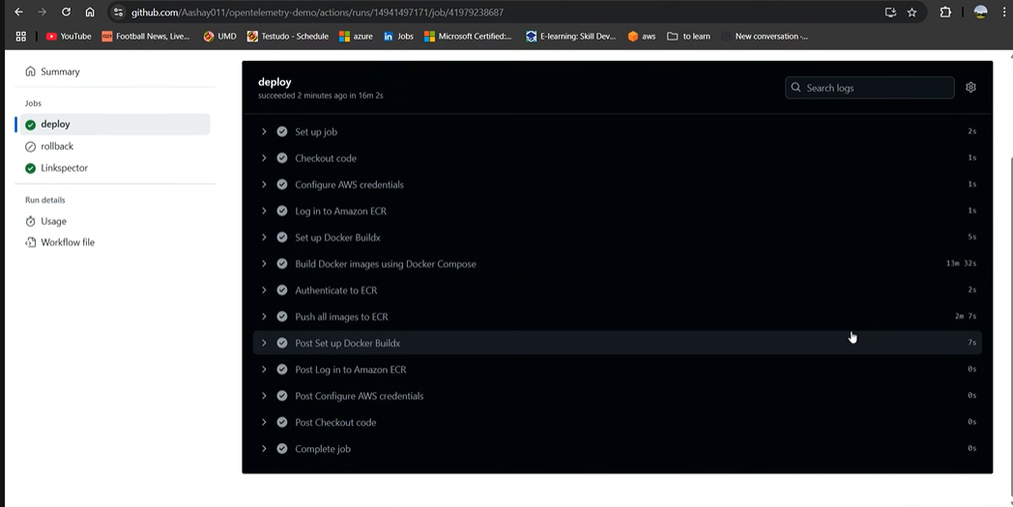
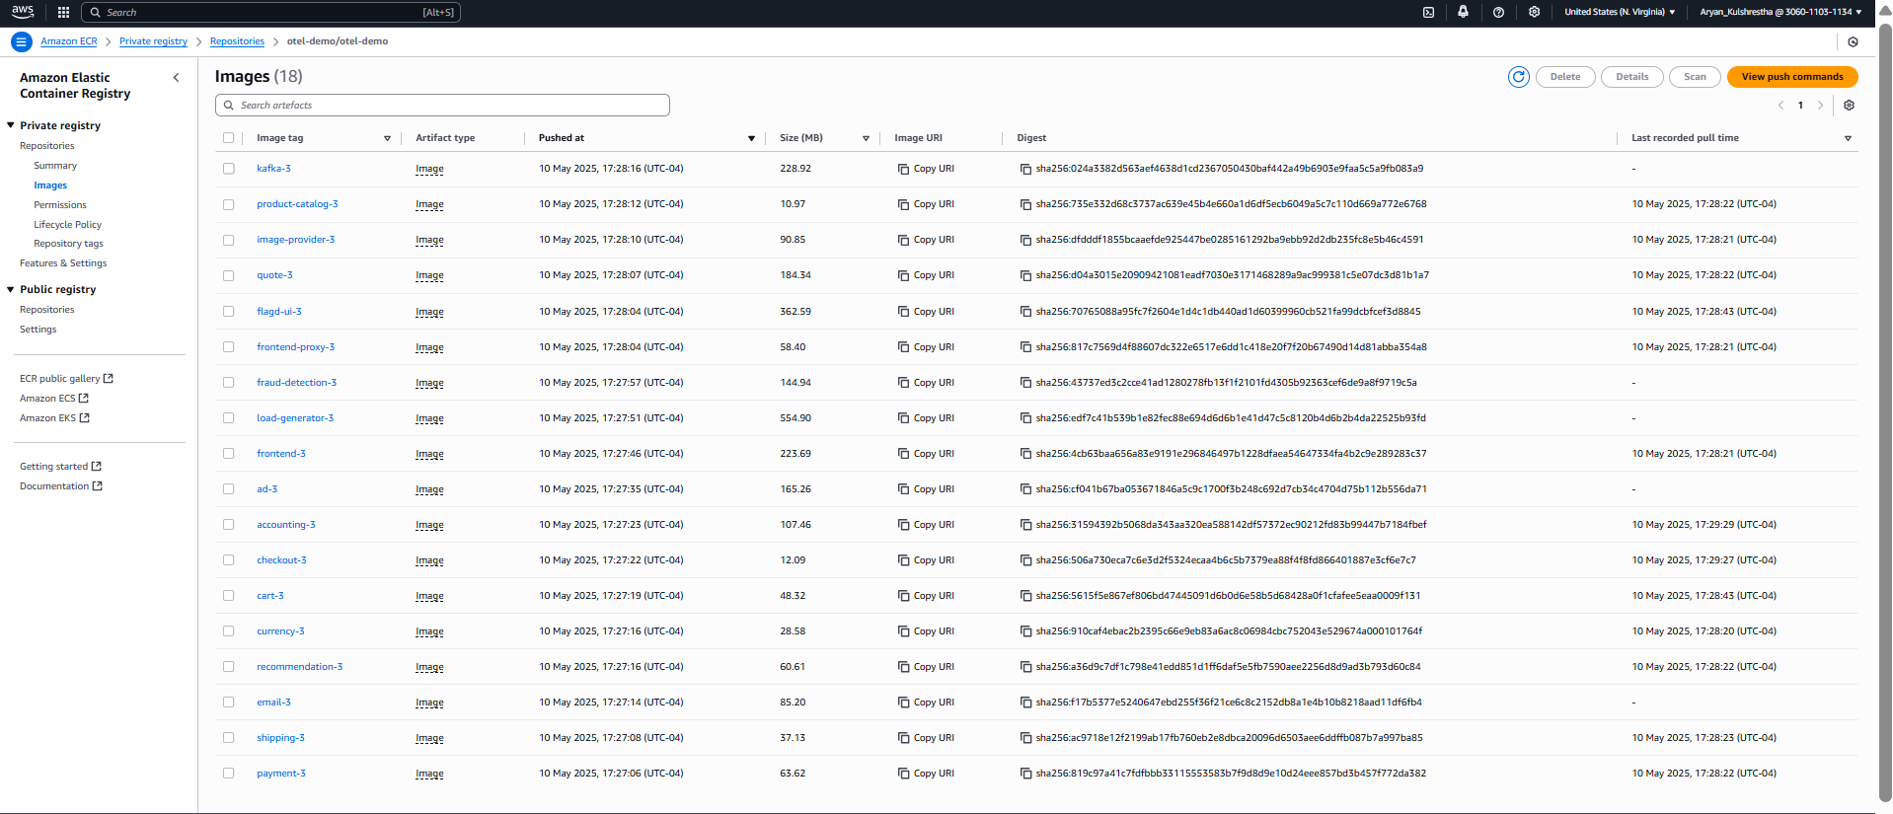
Phase 4: CI/CD Integration - Part 2
Screenshots showing Pipeline Deployments and Images in the ECR

Slide 19
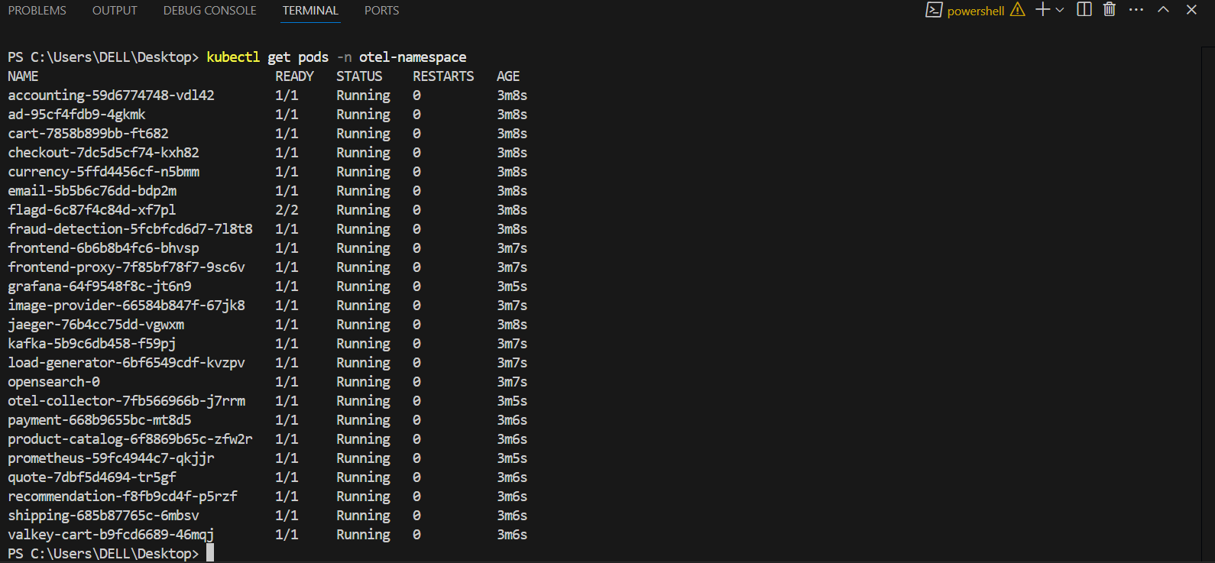
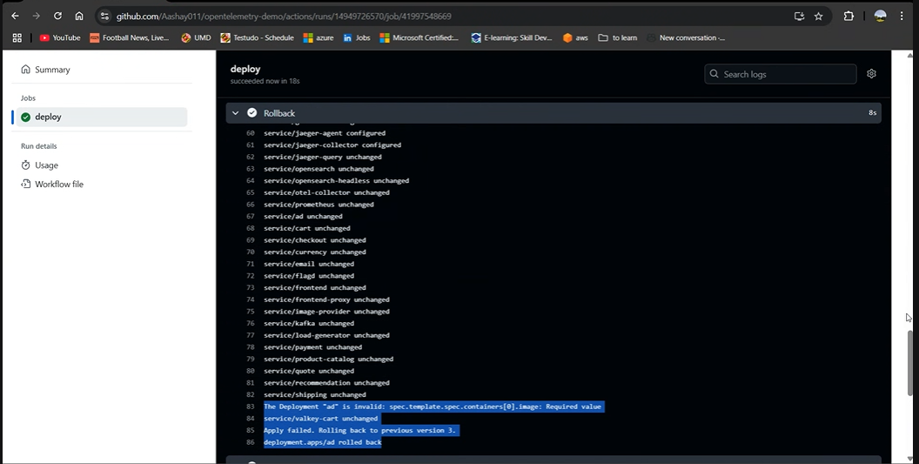
Phase 4: CI/CD Integration - Part 3

Slide 20
Challenges Encountered
Grafana Startup issues
Setting up the alert manager to send emails to Gmail.
Resolving the issue of creating redundant resources.
Containerising and deploying the images
Implementing Rollback

Slide 21
Lessons Learned
Deploying with Helm Simplifies Management
Namespace Isolation Matters
CI/CD Pipelines Enable Consistent Delivery
Resource Cleanup Is Critical for Stability
Cluster Security & Access Control
Containerisation and Orchestration
Security Should Be Proactive, Not Reactive

